Slide 1
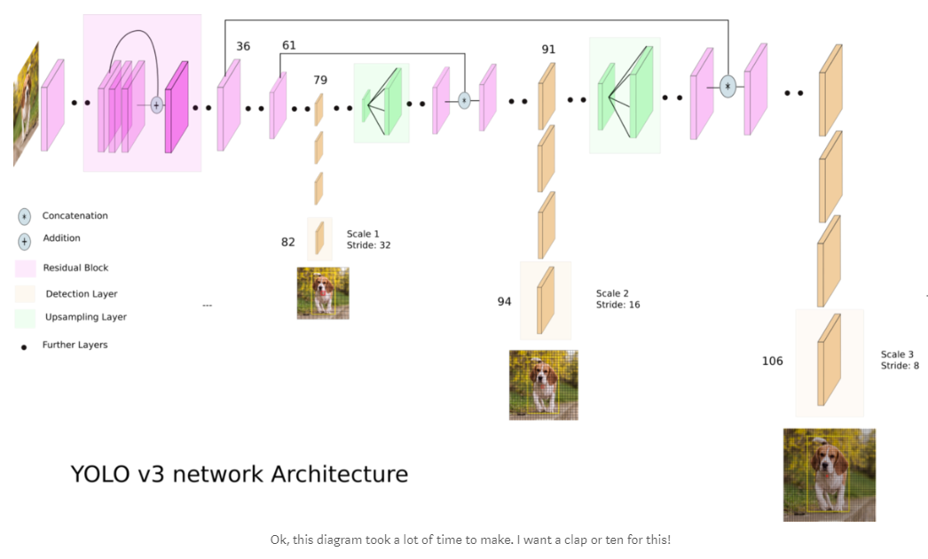
1. YOLO_v3 전체 Network
출처: https://towardsdatascience.com/yolo-v3-object-detection-53fb7d3bfe6b

Slide 2
Input Image (416x416x3)
Conv3x3 (416x416x32)
2. DarkNet-53 (backbone network)
Conv3x3/2 (208x208x64)
Conv1x1 (208x208x32) Conv3x3 (208x208x64)
Residual (이하 생략)
1x
Conv x*x/n에서 x와 n은 filter size, stride를 의미
모든 Conv 연산은
Convolution - Batch Normalization – LeakyReLU
총 5번의 *Down-sample
Conv3x3/2 (104x104x128)
2x
Conv1x1 (104x104x64) Conv3x3 (104x104x128)
Conv3x3/2 (52x52x256)
8x
Conv1x1 (52x52x128) Conv3x3 (52x52x256)
Conv3x3/2 (26x26x512)
8x
Conv1x1 (26x26x256) Conv3x3 (26x26x512)
Conv3x3/2 (13x13x1024)
4x
Conv1x1 (13x13x512) Conv3x3 (13x13x1024)

Slide 3
3. YOLO_v3 layer
(52x52x256)
(26x26x512)
Conv1x1 (13x13x512)
Conv3x3 (13x13x1024)
Conv1x1 (13x13x512)
Conv3x3 (13x13x1024)
Conv1x1 (13x13x512)
Conv1x1 (26x26x256)
Conv3x3 (26x26x512)
Conv1x1 (26x26x256)
Conv3x3 (26x26x512)
Conv1x1 (26x26x256)
Conv1x1 (52x52x128)
Conv3x3 (52x52x256)
Conv1x1 (52x52x128)
Conv3x3 (52x52x256)
Conv1x1 (52x52x128)
DarkNet-53
(416x416x3)
Conv1x1
(13x13x256)
Interpolate
(26x26x256)
Concat
(26x26x768)
Conv1x1
(26x26x128)
Interpolate
(52x52x128)
Concat
(52x52x384)
Conv3x3 (13x13x1024)
Conv3x3 (26x26x512)
Conv3x3 (52x52x256)
Convolution1x1 (13x13x255)
Convolution1x1 (26x26x255)
Convolution1x1 (52x52x255)
Conv는 DarkNet-53과 같은 연산
Convolution은 convolution만 이용
총 2번의 *Up-sample (Interpolate)
총 3개의 *Outputs

Slide 4
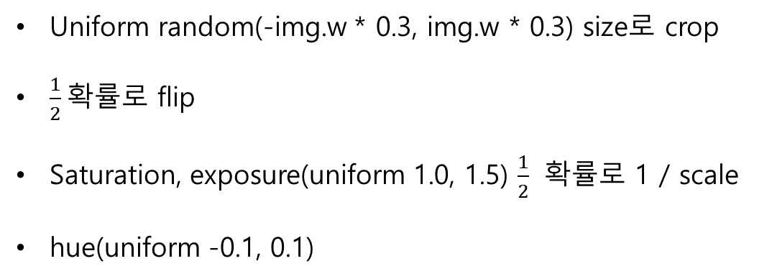
4. YOLO_v3 augmentation
Uniform random(-img.w * 0.3, img.w * 0.3) size로 crop
$\frac{1}{2}$확률로 flip
Saturation, exposure(uniform 1.0, 1.5) $\frac{1}{2}$ 확률로 1 / scale
hue(uniform -0.1, 0.1)

Slide 5
5. YOLO_v3 output
Convolution1x1 (gird_x*grid_y*x255)
3개의 output_shape = (bs, grid_x, grid_y, 3*85)
Grid_x, grid_y = 13, 26, 52
각 gird_cell 당 3개의 anchor_box
각 anchor_box 당 80개의 class, confidence, (x, y, w, h)

Slide 6
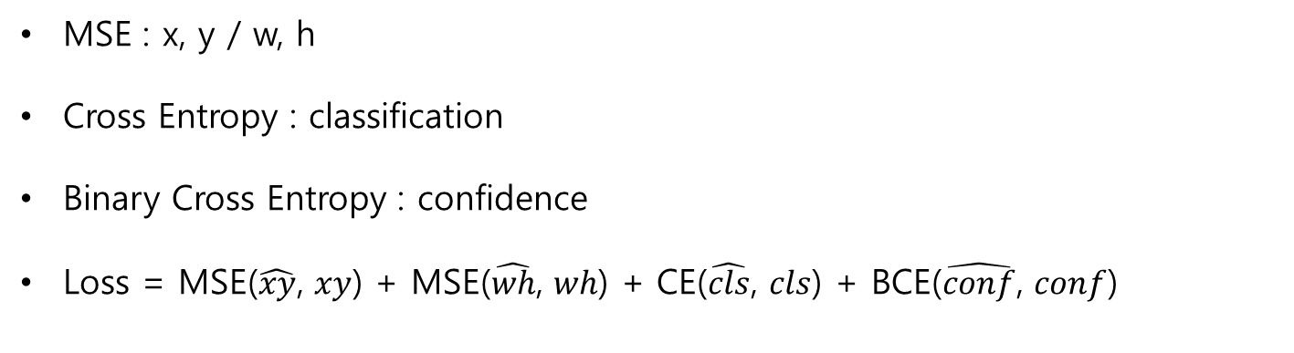
6. Loss
MSE : x, y / w, h
Cross Entropy : classification
Binary Cross Entropy : confidence
Loss = MSE($\hat{xy}$, $xy$) + MSE($\hat{wh}$, $wh$) + CE($\hat{cls}$, $cls$) + BCE($\hat{conf}$, $conf$)

